Slide 1
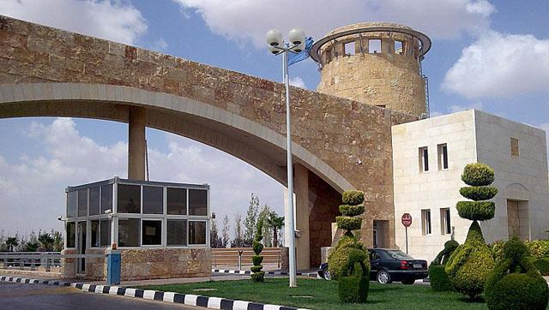
local INVENT Meeting progress in the Project Oct. 24-28, 2016 Leipzig-Germany

Slide 2
WP Leader:
JUST
ARCA & JO partners
Duration:
15.10.2015 to 15.4.2016
WP1
Analysis of training needs

Slide 3
Tasks:
1.1 Review local market needs for qualified people in the field of innovation and entrepreneurship
1.2 Identify training needs for officers of CTIs
Status:
1.1 Report on Local needs has been finalized by JUST and sent to ARCA & P&B in order to prepare the long term capacity building plan.INVENT-academic survey analysis pp.pptx
INVENT-survey analysis pp.pptx
1.2 ARCA and P&B have prepared the training program based on local needs

Slide 4
WP 2
Training of trainers for participation at CTIs
WP Leader:
ARCA
P&B
Duration:
15.4.2016 to 15.4.2017

Slide 5
Tasks:
2.1 Development of Long-Term Capacity Building Plan
2.2 Selection of Training Staff
2.3 Consultations with the Jordanian co-beneficiaries.
2.4 Training of trainers for participation at CTIs.
Status:
2.1 ARCA and P&B have prepared the final long term capacity.
2.2 All of JO partners have prepared criteria for staff selection
ARCA has prepared criteria for allocating staff in the training centers according to their needs and qualifications
2.3 Pending
2.4 Pending

Slide 6
WP 3
Establishment and equipment of the CTIs
WP Leader:
HTWK
PUST
Duration:
1.12.2015 to 1.7.2016

Slide 7
Tasks:
3.1 Establishment of center offices and departments.
3.2 Hardware equipment at the Centers.
3.3 Installation and adjustment of software.
Status:
3.1 All of JO Universities have established CTI.
3.2 Tender to purchase equipment needed for the CTIs has been finalized. It is expected that equipment will be installed before the end of 2016
3.3 Software will be installed by the first two weeks of Jan. 2017.

Slide 8
WP 4
Activity of the Centers and departments
WP Leader:
HTWK
JO Partners
Duration:
15.4.2016 to 15.10.2018

Slide 9
Tasks:
4.1 Creation of web-site and support its functioning
4.2 Creation of database of CTIs and support function
4.3 Training activity
4.4Consulting activity
Status:
4.1 JUST has established the website of INVENT
4.2 JUST and HCST are working on this task
4.3 Pending.
4.4 Pending.

Slide 10
WP 5
Project assurance and efficiency
WP Leader:
CRE.THE.DEV
MU
Duration:
17.11.2015 to 1.10.2018

Slide 11
Tasks:
5.1 Establish the Quality committee.
5.2 Develop a monitoring, evaluation, and quality (MEQ) plan.
5.3 Write progress reports that elaborate the progress of the project and address it to the project coordinator.
5.4 Hire External Monitor
Status:
5.1 QC was established during the kick-off meeting
5.2 CRE.THE.DEV has developed the MEQ plan
5.3 Pending.
5.4 JUST in collaboration with the QC leader recruited and hired an external monitor

Slide 12
WP 6
Dissemination, exploitation of results, and sustainability
WP Leader:
ARC
UJ
Duration:
15.4.2016 to 20.9.2018

Slide 13
Tasks:
6.1. Developing a dissemination and exploitation plan.
6.2. Elaboration of project image and dissemination materials.
6.3. Organizing workshops and info-days.
Status:
6.1 - ARCA has prepared a dissemination and exploitation plan.
- JUST created a Facebook page to disseminate all INVENT activities.
6.2 - ARCA circulated useful material.
- ARCA prepared the design of INVENT brochures and folders
- JUST printed the designed brochures and folders
6.3 JUST organized many workshops to disseminate INVENT Project

Slide 14
Tasks:
6.4. Organizing an Electronic Town Meeting.
6.5. Organizing Local Final Conference.
6.6. Developing a sustainability plan.
Status:
6.4 - JUST and ASRF organized an ETM on Innovation in Jordan on Oct. 17, 2016
- JUST organized training programs on ETM for all JO partners during Oct. 15-
16, 2016. contacted an Italian company to organize the ETM
6.5 Pending
6.6 Pending

Slide 15
WP 7
Management and Operational Structures
WP Leader:
JUST
Duration:
15.10.2015 to 15.10.2018

Slide 16
Tasks:
7.1. Organizing the Kick-off Meeting and other consortium meetings.
7.2. Establishment of management and operational structures.
7.3. Establishment of Training and Technical Group (TTG).
7.4. Hiring External Auditors.
7.5. Reports.
7.6. External Auditors.
Status:
7.1 Completed in Feb 2016.
7.2 Completed in Feb 2016.
7.3 Completed in Feb 2016.
7.4 JUST has contracted ASIA Co. as an external auditor.
7.5 On-going process.
7.6. EU partners will be contacted to have the list of external auditors

